Slide 1
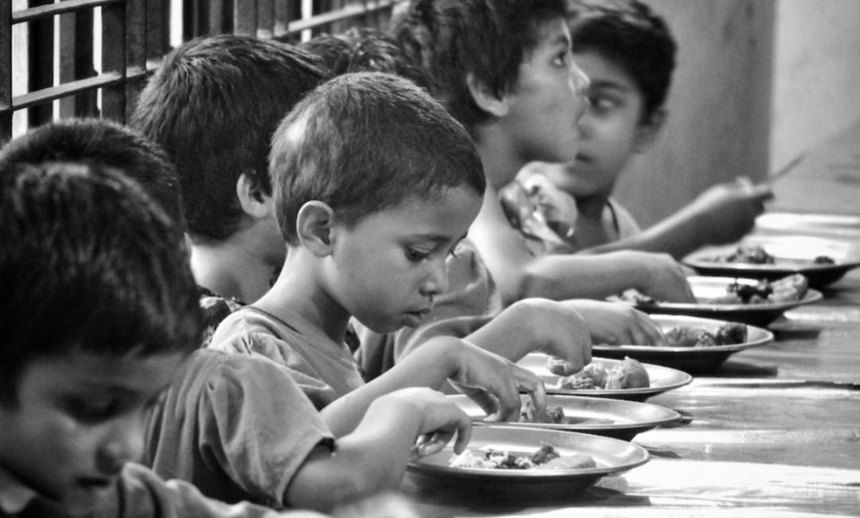
WARM HEARTS

Slide 2
WHY WARM HEARTS?
PROBLEM STATEMENT
Food wastage and problem of hunger are two huge-crisis arising in today’s world.
Tons of food is thrown as waste every year.
Additionally, one-thirD of the food consumed is stated as surplus. Nearly 40 per cent of the food produced in India is wasted every year due to fragmented food systems and inefficient supply chains.
Children who lives in orphanage suffers from many problems both financially and emotionally.

Slide 3
WHY WARM HEARTS?
Objective
The main objective of this project is to avoid wastage of food unnecessarily and providing it to the orphanage who are in need.
Courses are provided by volunteers to improve the skills of orphans rather than academics.
Donors get a clear description of every orphanage and they can donate to The particular orphanage that they wish to.
They can donate food, money,books, clothes or they can directly visit to the orphanage and help them. Visitors can also write blog on orphanage and can give feedback.
Receiver will get a message on telegram once the donor has donated. And also donor will get a message when receiver accepts it.

Slide 4
WHY WARM HEARTS?
Modules in our project
Donor module
Receiver module
Food Donation module
Admin module

Slide 5
WHY WARM HEARTS?
Queries that we have used
Create
Insert
Update
Select
Delete

Slide 6
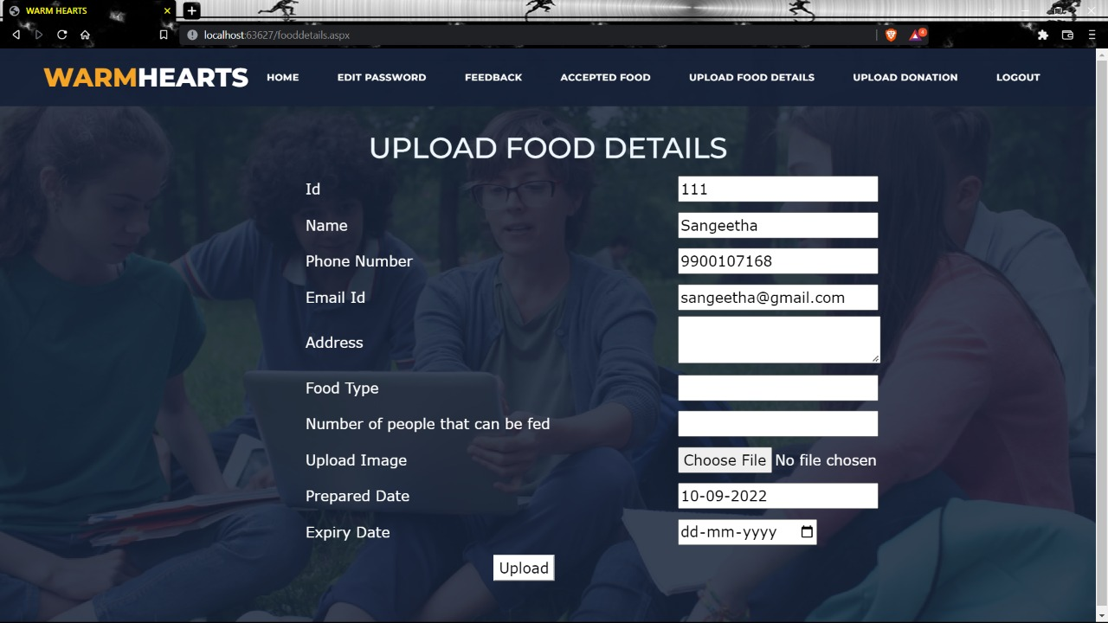
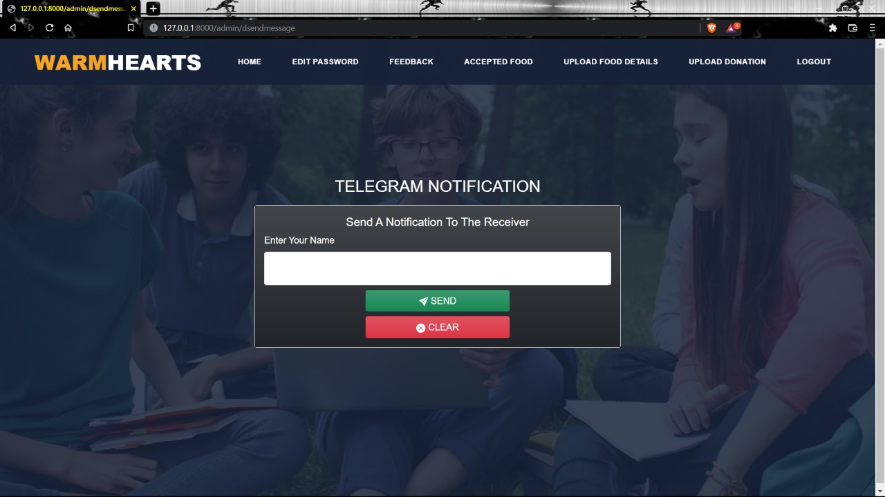
Donating food and sending a message to receiver

Slide 7
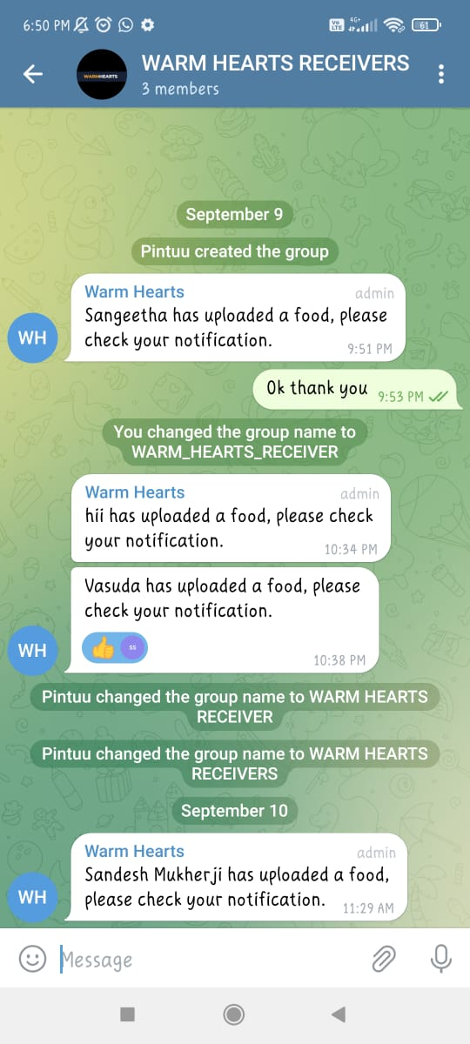
Telegram notification to receiver

Slide 8
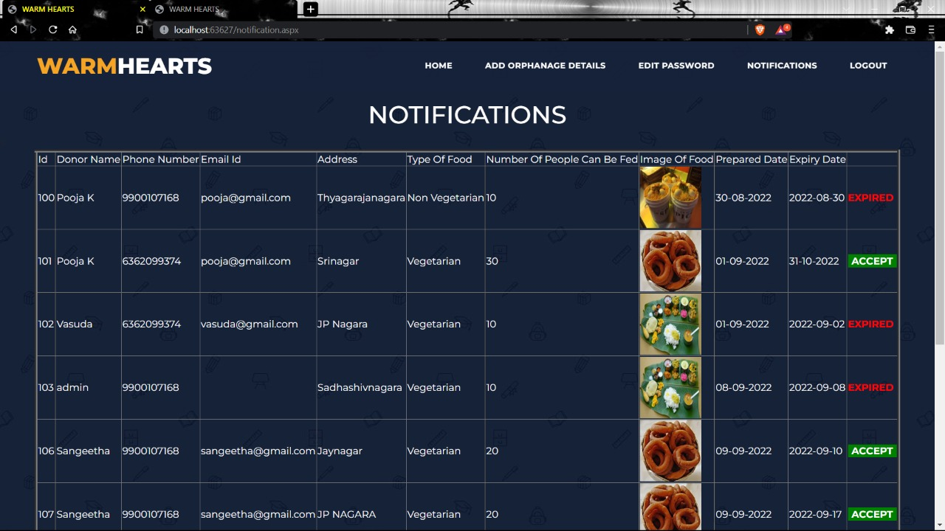
NOTIFICATION RECEIVED by receiver

Slide 9
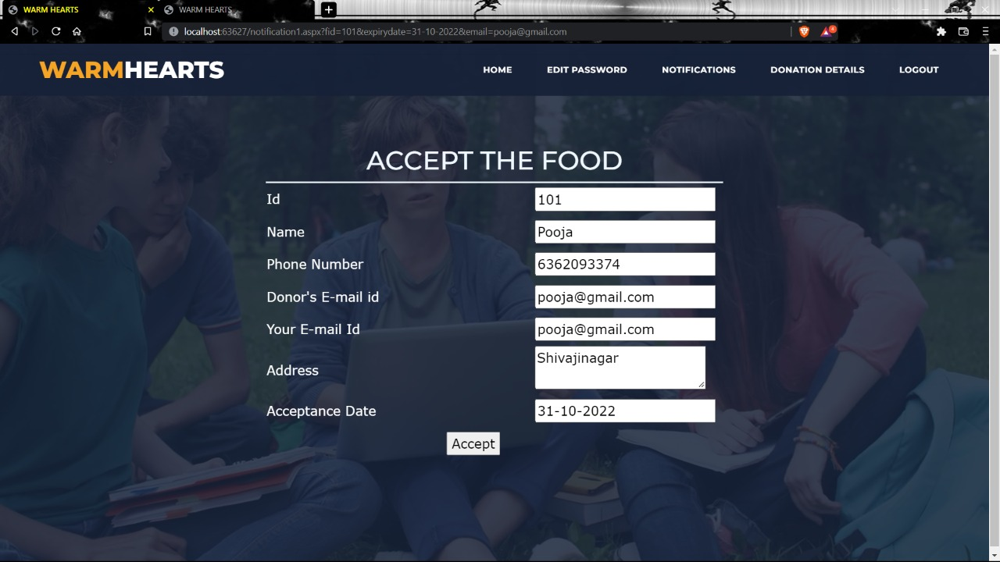
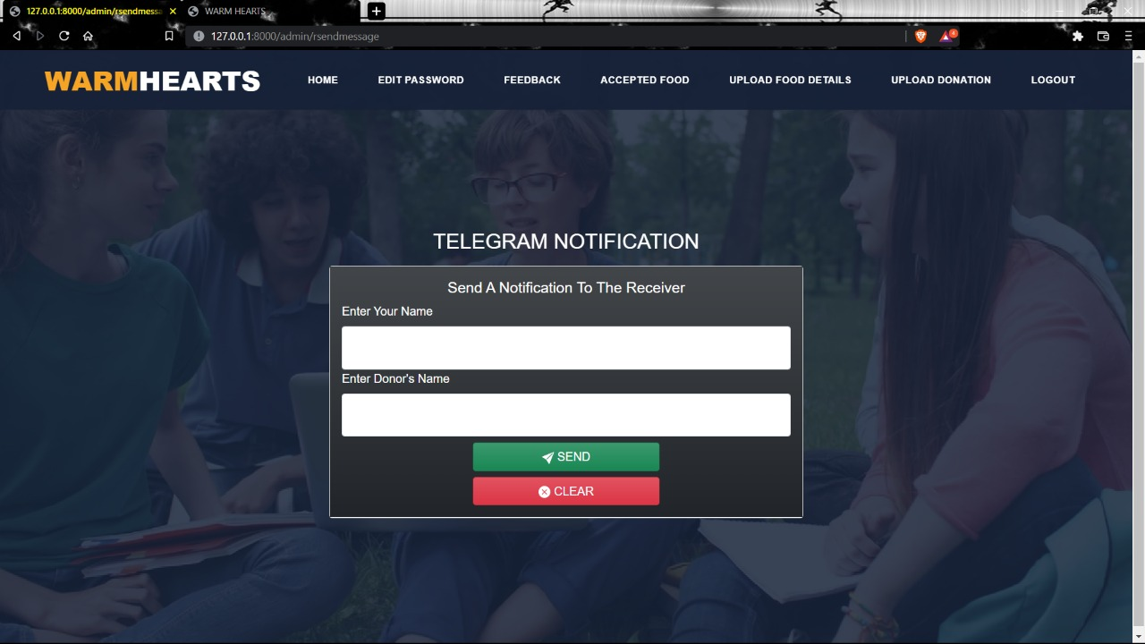
Accepting the food and sending notification to donor through telegram

Slide 10
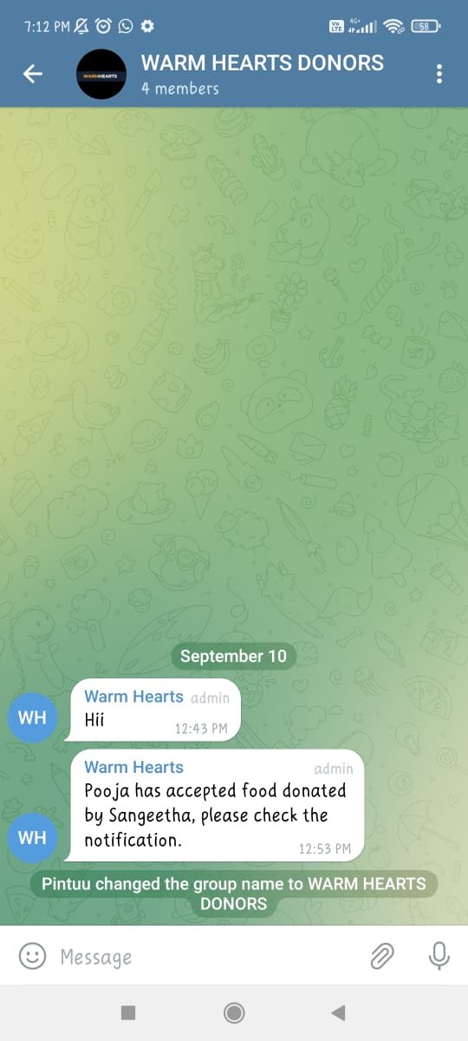
Food accepted

Slide 11
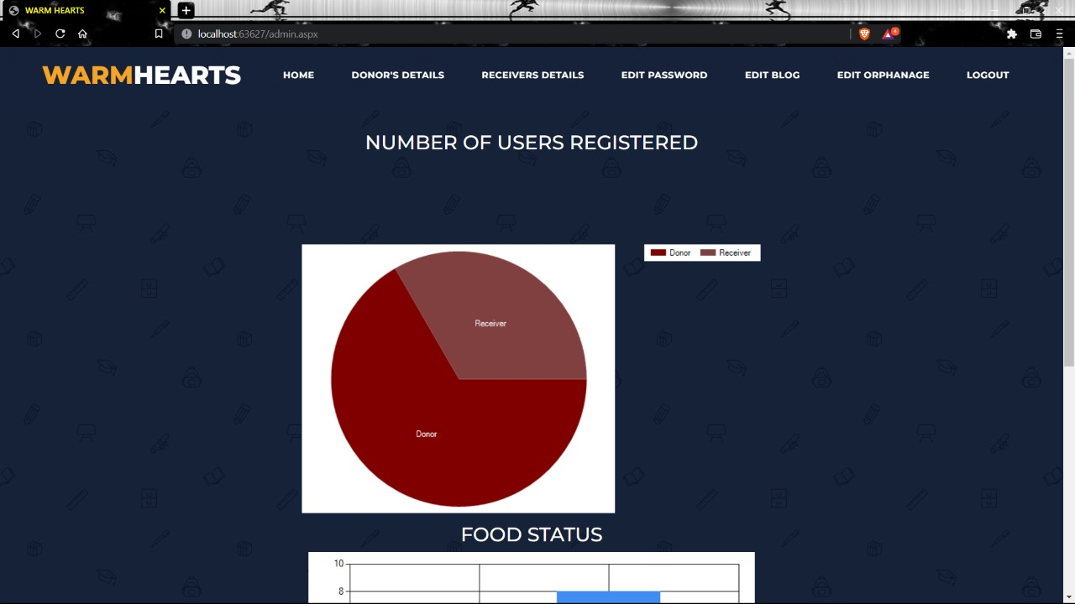
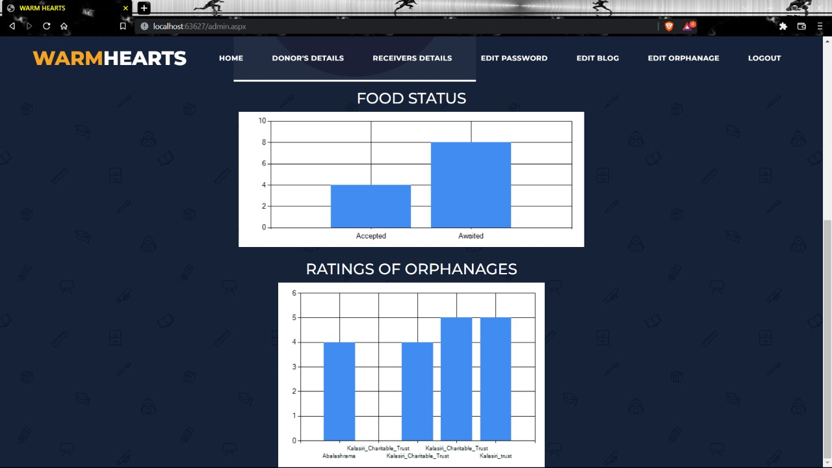
Data visualization

Slide 12
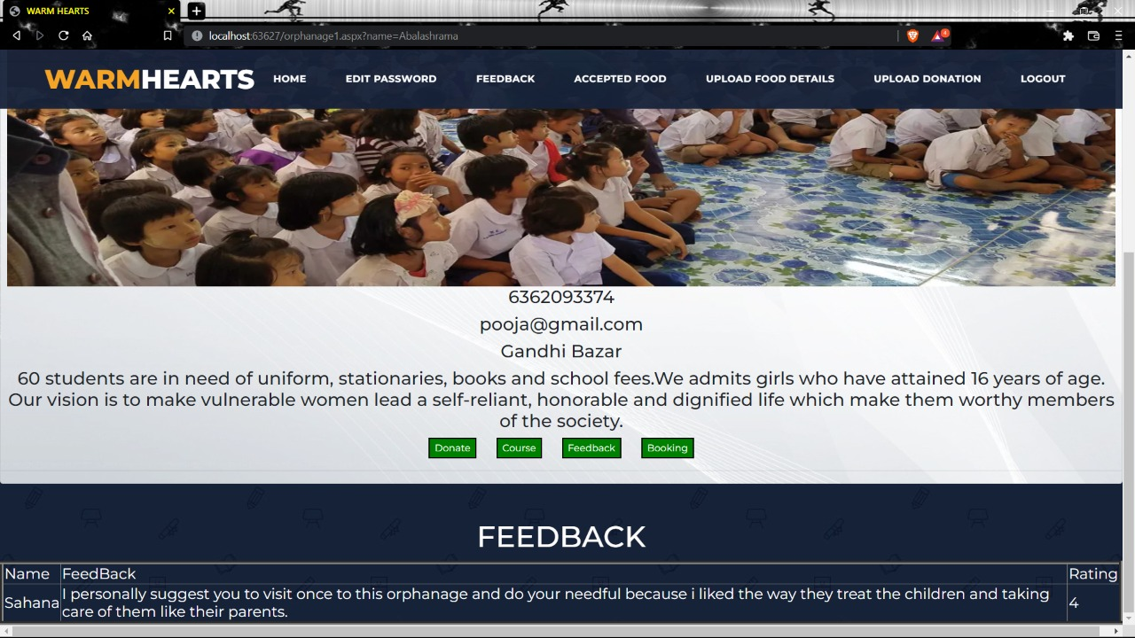
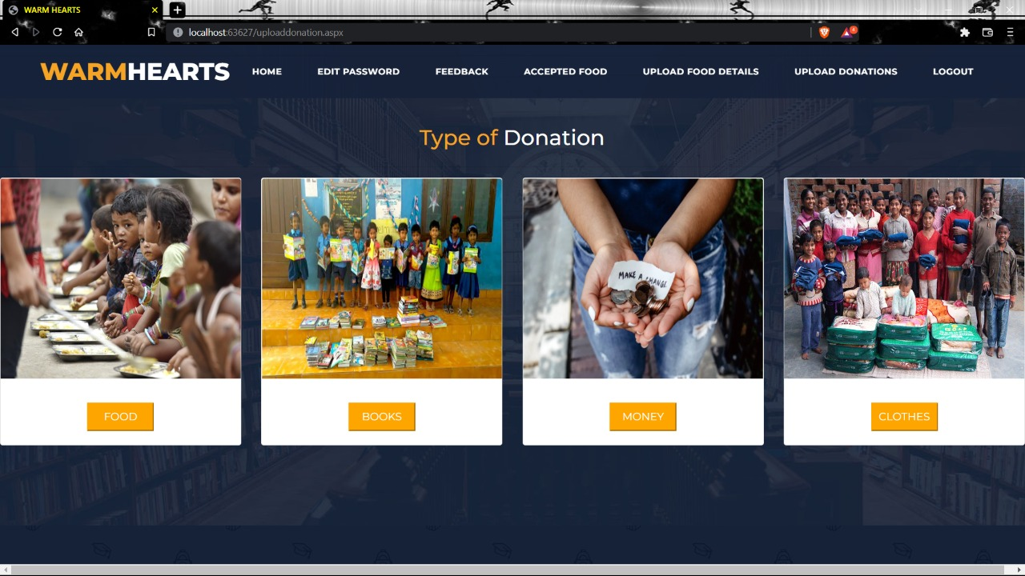
Different ways of helping orphanage

Slide 13
Future enhancement
Connecting donor with every orphanage is the goal of the project. Making the website more dynamic by tracking the location from where the donation has been sent so that the nearest orphanage can receive the food before the expiry of the food.
Donating money to the orphanage using razor pay api methods is our further goal.
Providing the meeting links to the orphanage by the volunteers and making them more interactive is our goal where it helps orphans to learn extra curriculum activities.
Sending updated information about the website and orphanage through normal messages which can be accessed offline also is our further goal. As of now to achieve that we have integrated telegram which is free of cost.

Slide 14
Thank you

